Slide 1



Covid-19 Vaccination Dashboard
View in Power BI
Last data refresh:
3/17/2024 6:40:52 PM UTC
Downloaded at:
3/17/2024 10:29:49 PM UTC

Slide 2
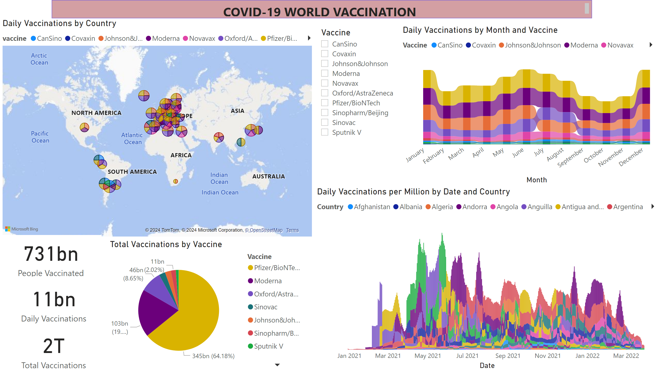
Covid-19 Vaccine
Notes:
ribbonChart
No alt text provided
Daily Vaccinations by Country
No alt text provided
card
No alt text provided
ribbonChart
No alt text provided
slicer
No alt text provided
textbox
No alt text provided
card
No alt text provided
card
No alt text provided
pieChart
No alt text provided

Slide 3
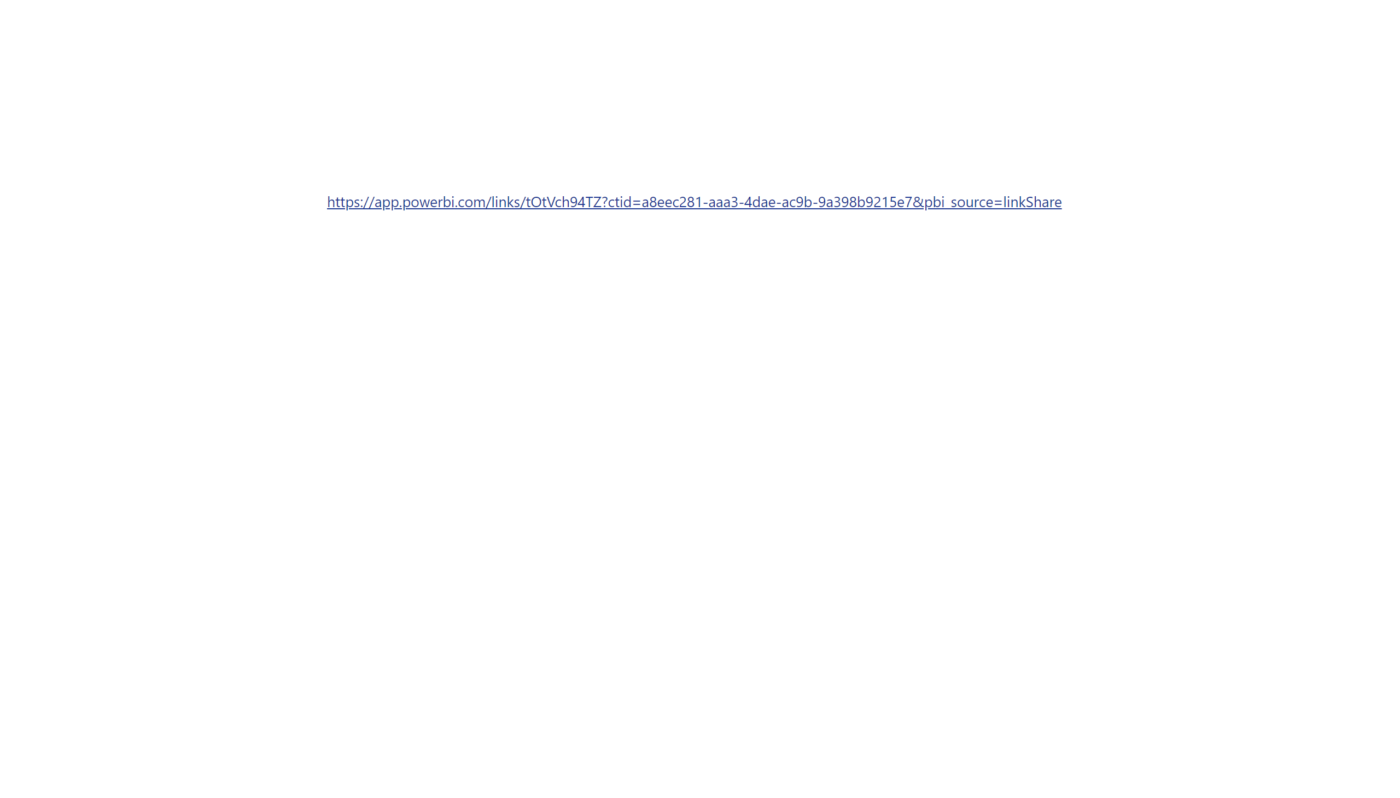
Page 1
Notes:
textbox
No alt text provided

